Slide 1
Section 1.3 Introductions to Complex Functions and Transformation Functions
© Copyright all rights reserved to Homework depot: www.BCMath.ca

Slide 2
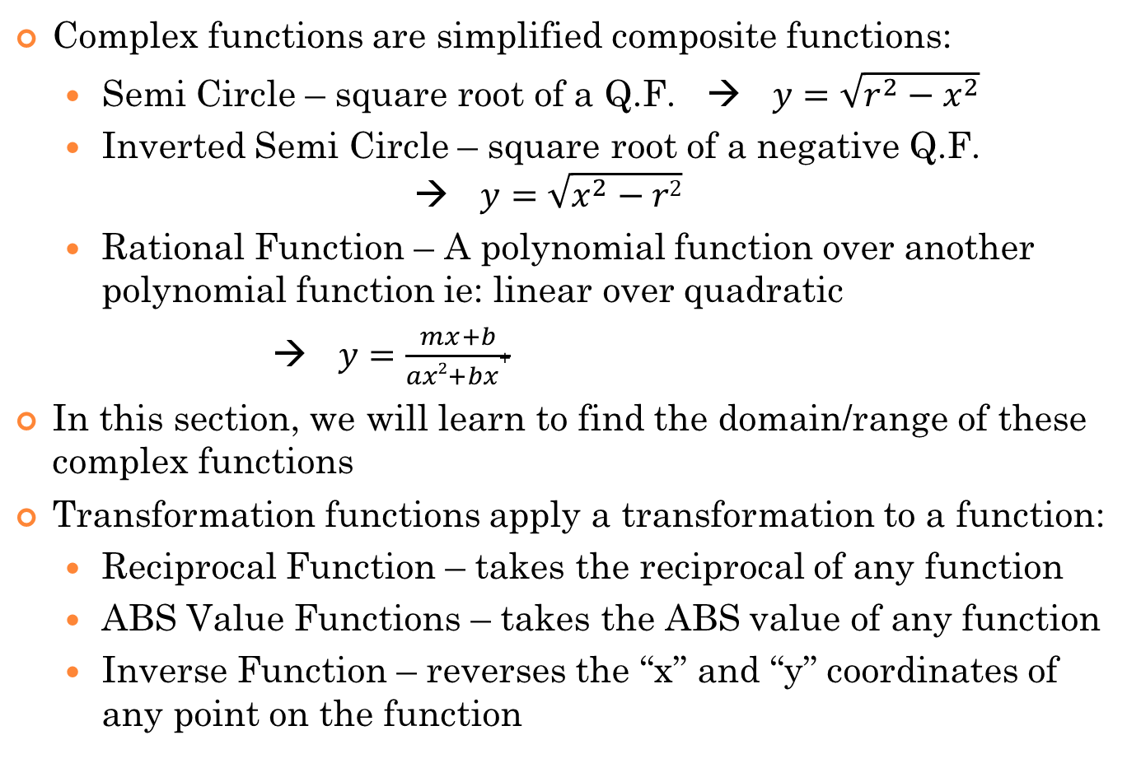
i) Complex and Transformation Functions
Complex functions are simplified composite functions:
Semi Circle – square root of a Q.F. → $y=\sqrt{r^{2}−x^{2}}$
Inverted Semi Circle – square root of a negative Q.F. → $y=\sqrt{x^{2}−r2}$
Rational Function – A polynomial function over another polynomial function ie: linear over quadratic
→ $y=\frac{mx+b}{ax2+bx+}$
In this section, we will learn to find the domain/range of these complex functions
Transformation functions apply a transformation to a function:
Reciprocal Function – takes the reciprocal of any function
ABS Value Functions – takes the ABS value of any function
Inverse Function – reverses the “x” and “y” coordinates of any point on the function

Slide 3
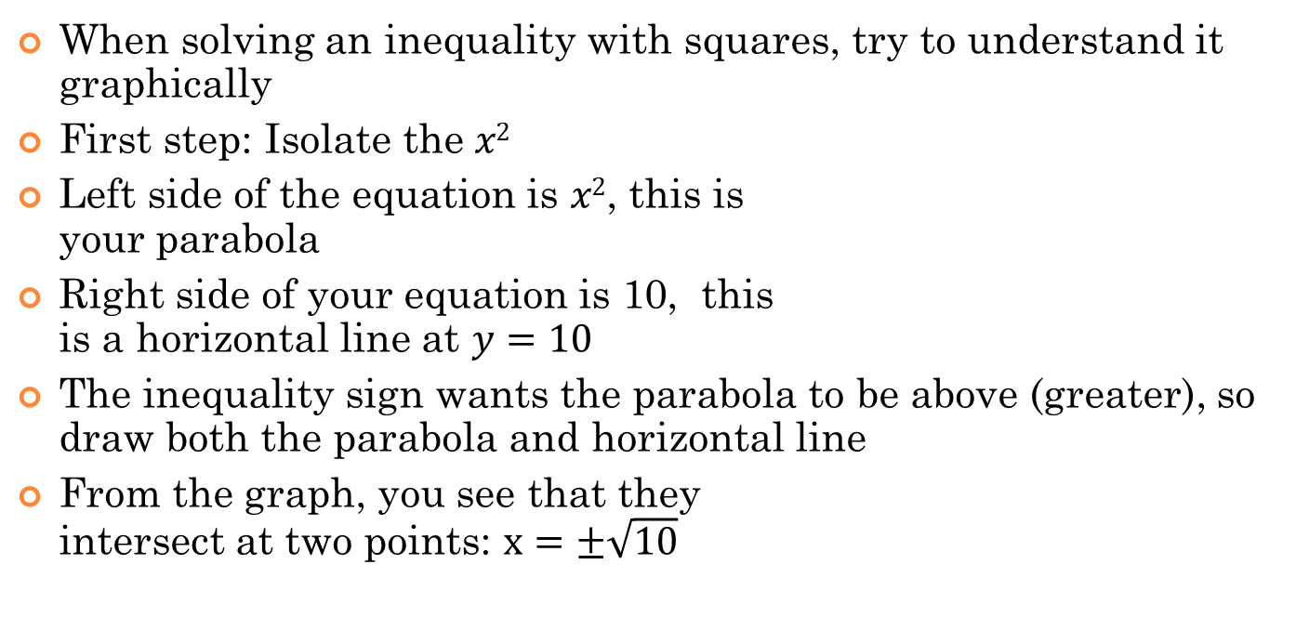
Review: Solving Inequalities with Squares:
When solving an inequality with squares, try to understand it graphically
First step: Isolate the $x2$
Left side of the equation is $x2$, this is your parabola
Right side of your equation is 10, this is a horizontal line at $y=10$
The inequality sign wants the parabola to be above (greater), so draw both the parabola and horizontal line
From the graph, you see that they intersect at two points: $x=±\sqrt{10}$
Parabola
Hor. Line
If we are solving:
If we are solving:
We want the domain that the parabola is above:
We want the middle with the parabola under the line:

Slide 4
Practice: Solve the following inequalities with squares:
All Real values

Slide 5
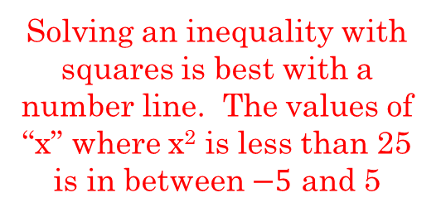
Domain/Range of Semi Circle Functions
A semi circle is in the form of, where “R” is the radius
Semi-Circle
To find the domain algebraically, the expression inside must be greater or equal to zero
Solving an inequality with squares is best with a number line. The values of “x” where x² is less than 25 is in between $−5$ and 5
Another way to find the domain/range is to use it’s graph
y
To find the range algebraically, find the center of the domain. Plug that back into the equation to get the height of the semi circle
5
4
3
2
1
-5
-4
-3
-2
-1
0
1
2
3
4
5
x
-1

Slide 6
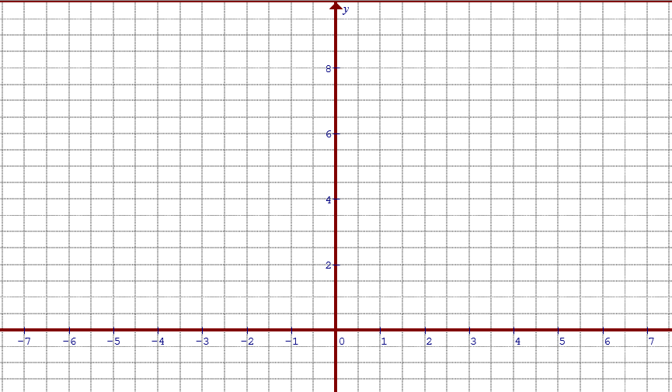
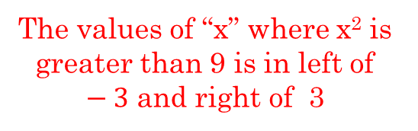
Inverted Semi Circle
Inverted Semi-Circle
The inverted semi circle is similar but the expression inside the radical is switched
The values of “x” where x² is greater than 9 is in left of $−3$ and right of 3
Graphically, the inverted semi circle would look like this:
The inverted semi circle is split into two parts. Therefore the domain will be two separate regions.
As for the range, the graph will increase towards infinity:

Slide 7
Ex: Find the domain/range of the composite function $y=f(g\left(x\right))$

Slide 8
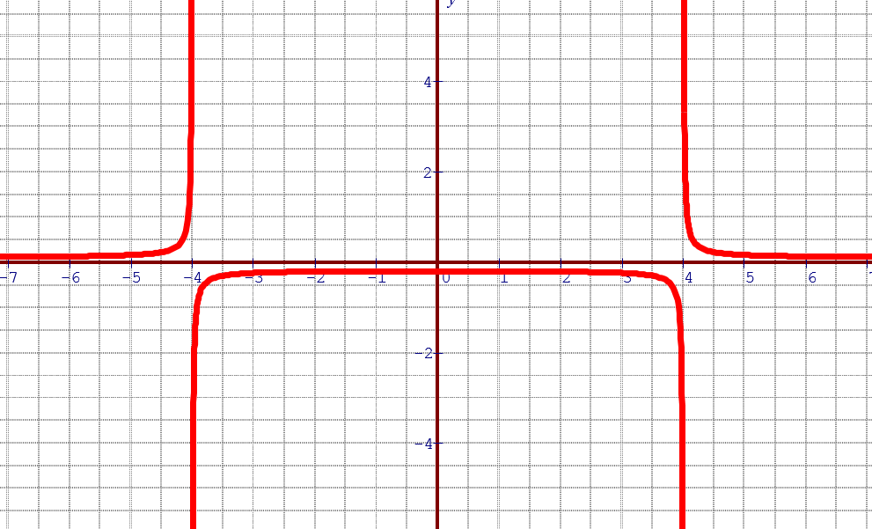
Reciprocal Functions
A reciprocal function has a “1” on top with an equation in the denominator
To find the domain, make the denominator equal to zero and then solve for “x”. These are your NPV’s
The range is a little harder to find. We will learn about finding the “range” of a reciprocal function in Ch2!!
Graphically, your reciprocal function will have two vertical asymptotes (borders). You will learn more about graphing reciprocal in a later chapter.
The range will be taught in ch2!!
Use the minimum of the denominator to find the range

Slide 9
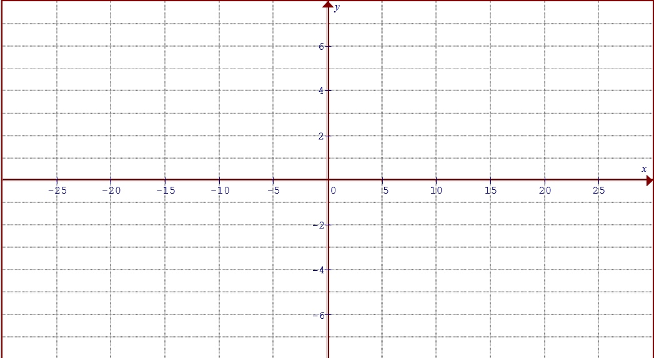
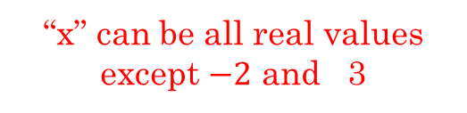
Rational Functions
A rational function is similar to a reciprocal function except you can have variables at the top
Finding the domain is the same as finding the NPV’s. The denominator can not be equal to zero
“x” can be all real values except $−2$ and 3
Finding the range of a rational function is quite difficult b/c of all the variations that can occur.
There are general rules for finding the range of a rational function that will be taught in a later chapter

Slide 10
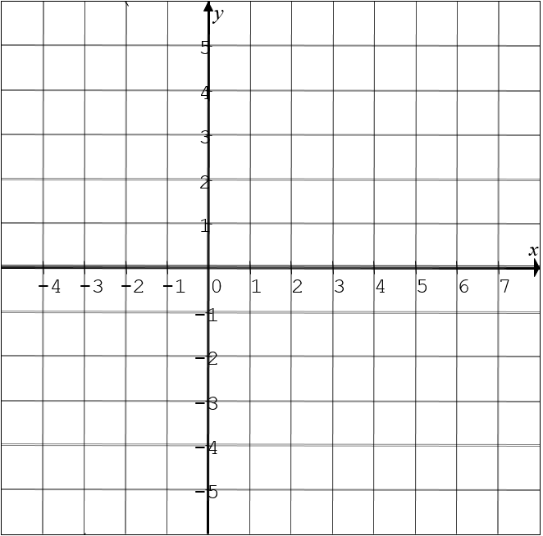
Transformation Funct: iii) Absolute Value functions
Suppose you are given a QF or any other function
The ABS Function will take any point with a negative y-coordinate, flip it, the y-coordinate will now be positive with the same x-coordinate
X-coordinate stays the same
Y-coordinate: +’ve →stays the same, –’ve → becomes +’ve
Input value can be all real numbers
Output value will be positive values

Slide 11
Which of the following equations has the same graph as:
Ex: Indicate the restrictions on the input and output values for each of the equations below:
Ex: Given the two equations, is there are difference in the restrictions of the output values? Explain:

Slide 12
Ex: Indicate the restrictions on the input and output values for each of the equations below:
INPUT values: No restriction
INPUT values: No restriction, a parabola will have no restriction on input
The inside equation is a linear function. Taking the Abs of the linear eq creates a V-shaped graph
This is a V-shaped graph, but with the minus one outside, it will reduce all output values by 1.
Output values of this parabola is 3 or greater. That means the ABS will not affect the output
INPUT values: No restriction
Since it’s an V-shaped graph, all output values will be positive
OUTPUT values: All output values are greater or equal to -1
OUTPUT values: All output values are greater or equal to 3
OUTPUT values: All output values are positive, so greater or equal to zero

Slide 13
Ex: Given the two equations, is there are difference in the restrictions of the output values? Explain:
All output values are positive: Greater or equal to zero
The minus 4 is taken outside of the Abs function. SO all output values are subtracted by 4.
All output values Greater or equal to -4

Slide 14

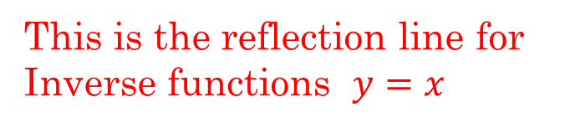
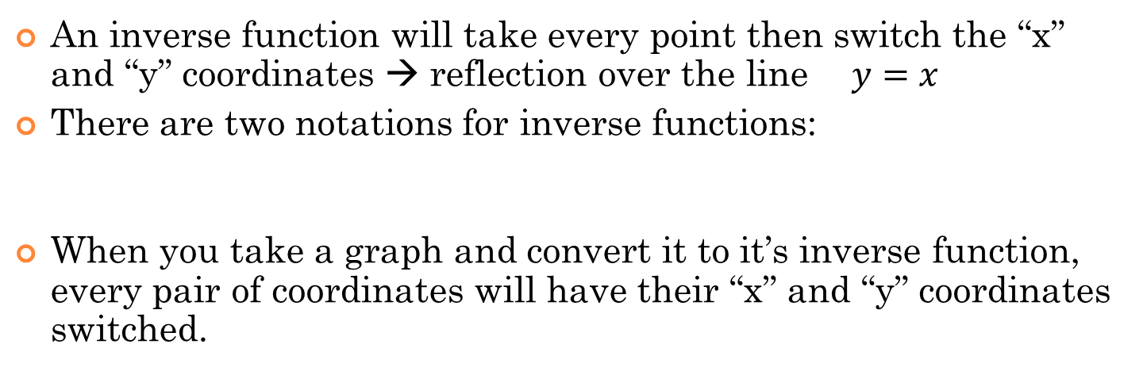
Transformation Functions) iii Inverse Function
An inverse function will take every point then switch the “x” and “y” coordinates → reflection over the line $y=x$
There are two notations for inverse functions:
When you take a graph and convert it to it’s inverse function, every pair of coordinates will have their “x” and “y” coordinates switched.
This is the reflection line for Inverse functions $y=x$

Slide 15
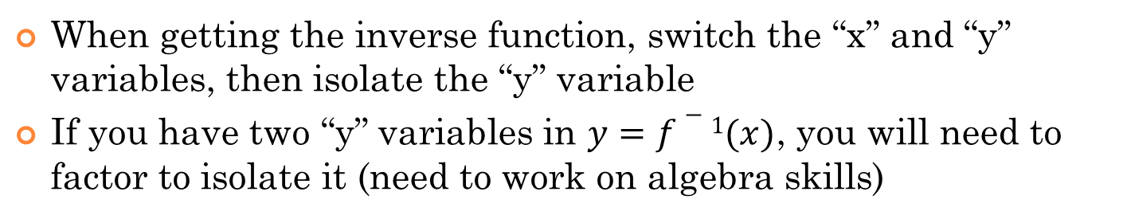
Getting the Inverse Function Algebraically:
When getting the inverse function, switch the “x” and “y” variables, then isolate the “y” variable
If you have two “y” variables in $y=f−1(x)$, you will need to factor to isolate it (need to work on algebra skills)
Original Function:
Inverse Function:
Suppose x=1, then:
The coordinates in the inverse function are switched
When x =1, y = –2
“x” coordinates of f(x)
“y” coordinates of f(x)

Slide 16
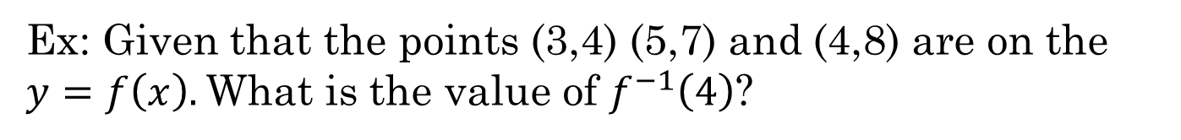
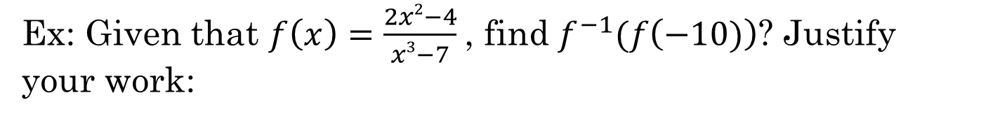
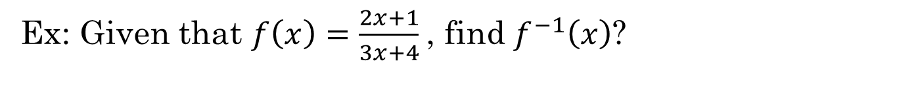
Ex: Given that the points (3,4) (5,7) and (4,8) are on the $y=f\left(x\right).$What is the value of $f^{−1}\left(4\right)$?
Ex: Given that $f\left(x\right)=\frac{2x+1}{3x+4}$, find $f^{−1}\left(x\right)$?
Ex: Given that $f\left(x\right)=\frac{2x2−4}{x3−7}$, find $f^{−1}(f\left(−10)\right)$? Justify your work:

Slide 17
Ex: Given that the points (3,4) (5,7) and (4,8) are on the $y=f\left(x\right).$What is the value of $f^{−1}\left(4\right)$?

Slide 18
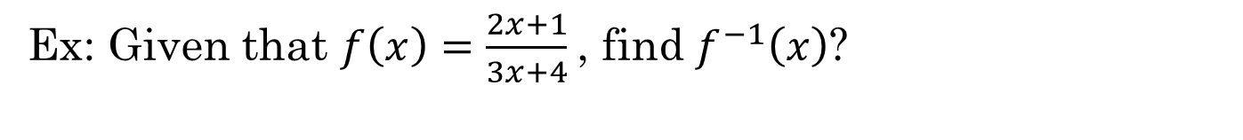
Ex: Given that $f\left(x\right)=\frac{2x+1}{3x+4}$, find $f^{−1}\left(x\right)$?

Slide 19
Given the function, find each of the following values
y
5
x
-5
0
5
-5
© Copyright all rights reserved to Homework depot: www.BCMath.ca

Slide 20
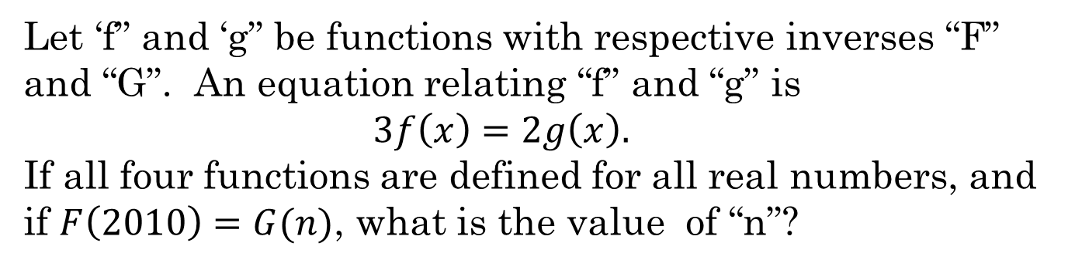
Let ‘f” and ‘g” be functions with respective inverses “F” and “G”. An equation relating “f” and “g” is $3f\left(x\right)=2g\left(x\right).$ If all four functions are defined for all real numbers, and if $F\left(2010\right)=G(n)$, what is the value of “n”?

